Slide 1
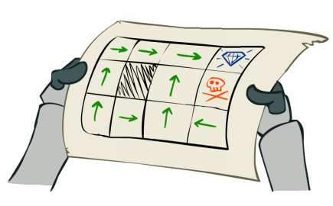
L7.1 MDP Planning
Zonghua Gu, Umeå University
Nov. 2023
Acknowledgement: slides based on https://www.coursera.org/specializations/reinforcement-learning
And textbook by Sutton and Barto http://incompleteideas.net/book/the-book-2nd.html

Slide 2
PilotNet [Bojarski 2016]
Bojarski M, Del Testa D, Dworakowski D, et al. End to end learning for self-driving cars[J]. arXiv preprint arXiv:1604.07316, 2016.

Slide 3
Training Method
End-to-End model trained with Imitation Learning (BC)
Human drives vehicle
Record sensor data and human actuator commands as training pairs
Train a DNN to map sensor data to actuator commands, mimicking a human. (PilotNet controls steering only. I think acceleration/braking are controlled separately, but the paper did not say how.)
PilotNet driving video:
https://www.youtube.com/watch?v=_N7nC-8YxzE
https://github.com/lhzlhz/PilotNet

Slide 4
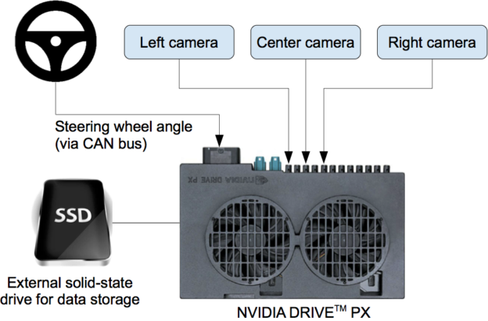
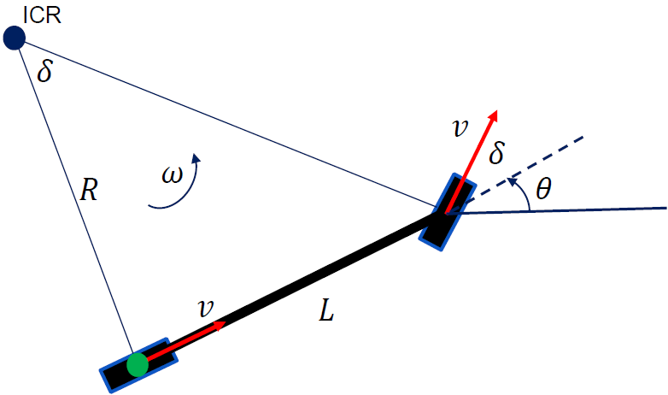
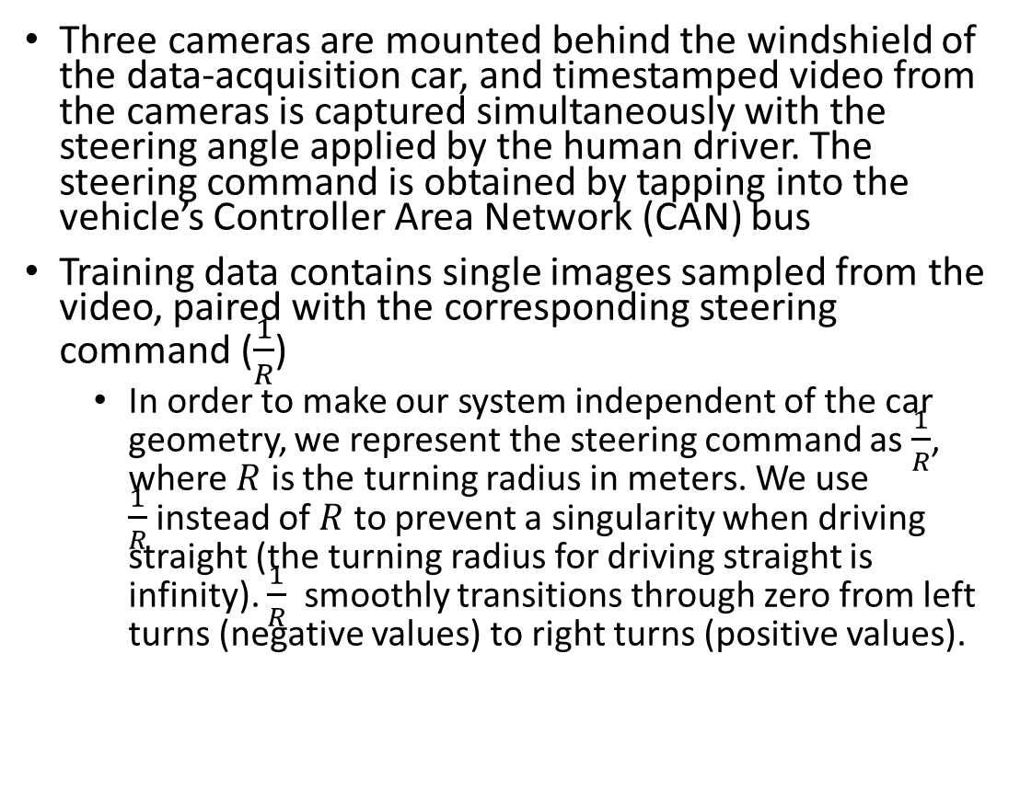


Data Collection System
Three cameras are mounted behind the windshield of the data-acquisition car, and timestamped video from the cameras is captured simultaneously with the steering angle applied by the human driver. The steering command is obtained by tapping into the vehicle’s Controller Area Network (CAN) bus
Training data contains single images sampled from the video, paired with the corresponding steering command ($\frac{1}{R}$)
In order to make our system independent of the car geometry, we represent the steering command as $\frac{1}{R}$, where $R$ is the turning radius in meters. We use $\frac{1}{R}$instead of $R$ to prevent a singularity when driving straight (the turning radius for driving straight is infinity). $\frac{1}{R}$ smoothly transitions through zero from left turns (negative values) to right turns (positive values).
https://devblogs.nvidia.com/deep-learning-self-driving-cars/
$$\frac{1}{R}=\frac{\tan{δ}}{L}$$
$$θ$$

Slide 5
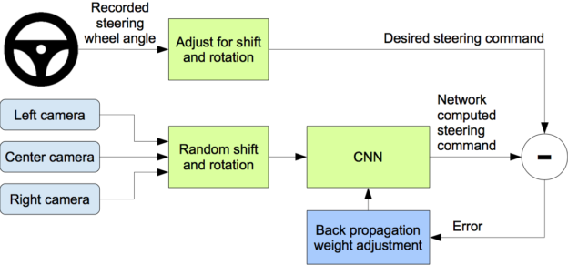
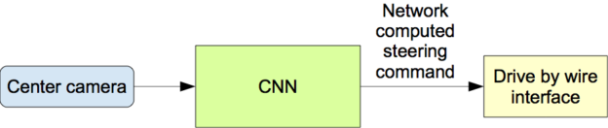
Training Data Augmentation
Problem: training data from human driver always stays in center of lane. So if car deviates from center, the image it sees is not in the training set, so it does not know the correct action.
Solution: Augment training data with additional images that show the car in different shifts from the center of the lane and rotations from the direction of the road. The images for two specific off-center shifts can be obtained from the left and the right cameras.
Training
Operation

Slide 6
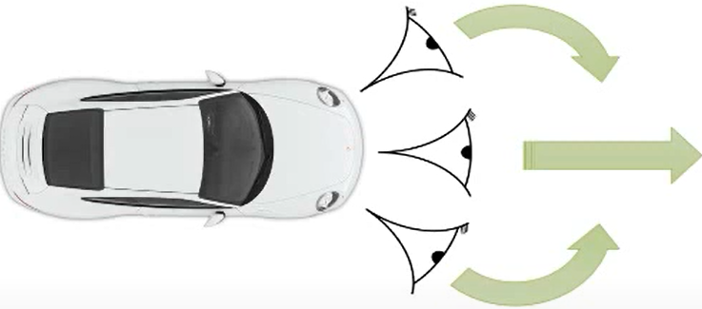
Training Data Augmentation Details
We augment the data by adding artificial shifts and rotations to teach the network how to recover from a poor position or orientation
Images for two specific off-center shifts can be obtained from the left and the right camera. Additional shifts between the cameras and all rotations are simulated by viewpoint transformation of the image from the nearest camera. The steering label for transformed images is adjusted to one that would steer the vehicle back to the desired location and orientation in two seconds
Ex.: Image from center camera shows car is driving straight; Shifted image from left camera shows car is leaning left. Associate this image with synthetic “turn right” command (even though human driver never issued it). During operation, if the center camera sees this image, issue “turn right” command

Slide 7
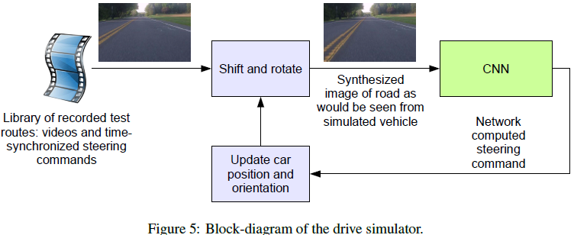
Driving Simulator
The simulator transforms the original images to account for departures from the ground truth. The magnitude of these perturbations is chosen randomly from a normal distribution.
7

Slide 8
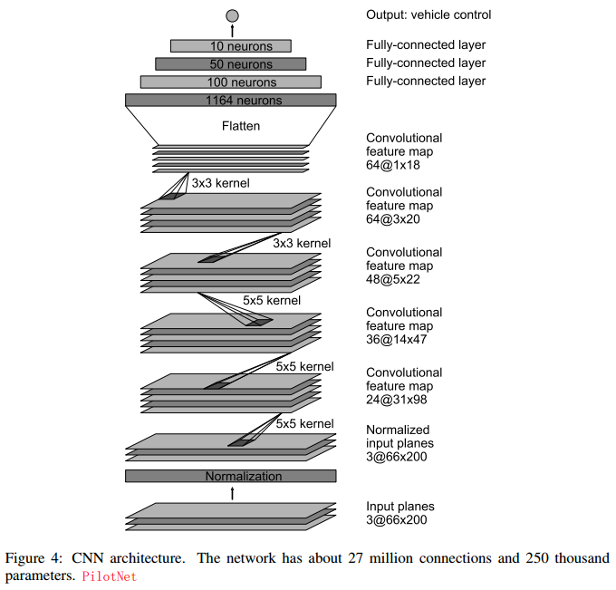
PilotNet CNN Architecture
~250K weights

Slide 9
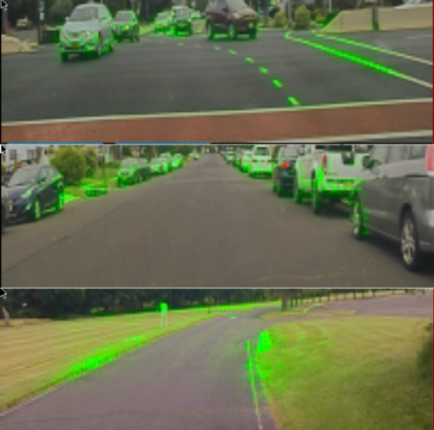
Visualization of Salient Objects
The visualization shows which regions of the input image contribute most to the output of the network. These regions identify the salient objects (highlighted in green).
PilotNet focuses on the same things a human driver would, including lane markers, road edges and other cars.
https://blogs.nvidia.com/blog/2017/04/27/how-nvidias-neural-net-makes-decisions/
Bojarski M, Yeres P, Choromanska A, et al. Explaining how a deep neural network trained with end-to-end learning steers a car[J]. arXiv preprint arXiv:1704.07911, 2017.

